Slide 1
Segmentation and Key Frame Extraction for Analyzing Educational Research Videos
Group: DKHTNI
Members: Xin Cai, Boyuan Zou, Jonquil Liao
“Ducks Keep Hunting Tiny Nymphs Intently.”
“Databases Keep Huge Tables Neatly Indexed.”

Slide 2
Project Background
The Need for Video Analysis Tools in Educational Research
Educational Psychology Research
Video Analysis
Students’ gestures as answering math problems
No tools automatically support for this
Task: Identify specific type of gestures
Examples: Representational gesture, (Non-)Dynamic gesture, etc.
Highly abstract concepts in educational psychology

Slide 3
Problem Statement
Developing an Intermediate Layer to Bridge Low-Level Data with High-Level Analytical Needs
High-level Needs (Identification of Abstract Gesture Type)
Intermediate Layer (Construction of Gesture Chunk) Our Project
Low-level Data (Coordinates of Body/Hands Landmarks)

Slide 4
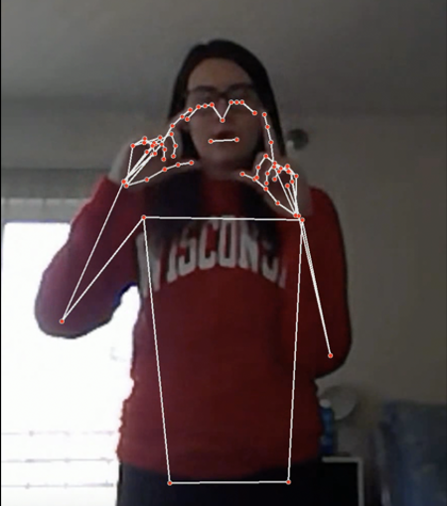
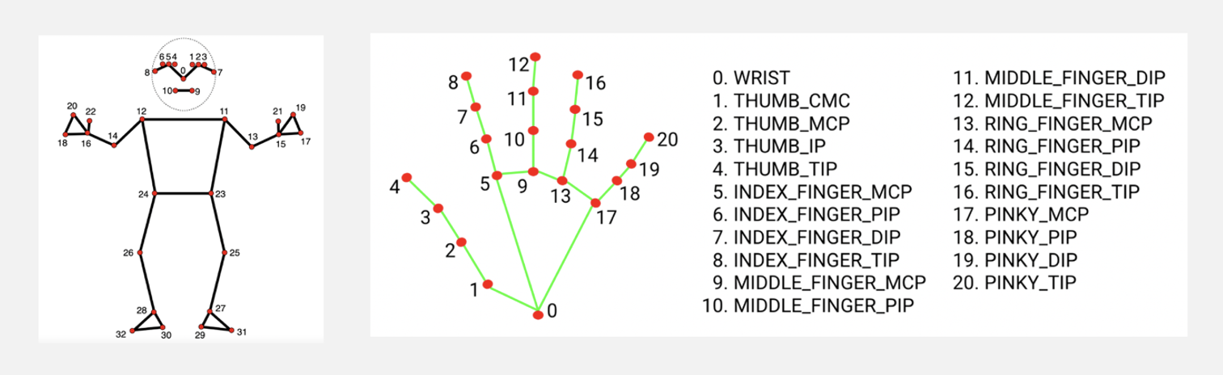
Data set
127 Video files (102 GB)
Research in Embodied Geometry
Magic Lab
Department of Edu Psych
Tools
OpenCV
Mediapipe
Stick figure model
Low Level Data:
Coordinates of
Body/Hands
Landmarks

Slide 5
High-Level Needs
# Unit of analysis
# Carrier of gesture-related features
struct Gesture Chunk {
# Identify ‘idle’ and
# ‘active’ sections
segmentation: TODO
# Recognition hand gesture
# for each hand in each frame
simple_hand_gestures: TODO
# Extract keyframes to summarize
# current chunk
keyframes: TODO
}
Intermediate Layer:
Construction of Gesture Chunk
Low-Level Data

Slide 7
Temporal Segmentation: Existing Algorithms
Papers
Key concepts
[1] Jiang, Feng, et al. "Multi-layered gesture recognition with Kinect." J. Mach. Learn. Res. 16.1 (2015): 227-254.
[2] Peng, Xiaojiang, et al. "Action and gesture temporal spotting with super vector representation." European Conference on Computer Vision. Cham: Springer International Publishing, 2014.
[3] Madeo, Renata CB, Clodoaldo AM Lima, and Sarajane M. Peres. "Gesture unit segmentation using support vector machines: segmenting gestures from rest positions." Proceedings of the 28th Annual ACM Symposium on Applied Computing. 2013.
Quantity of Movement
+ thresholding
Spatial distribution of hand positions
+ distance of current hand position to static position
Velocity and acceleration as feature vector + support vector machine classification
Notes:
There are different algorithms in the literature that address temporal segmentation. Most of these algorithms are specifically tailored to their datasets, making assumptions that are only true for their data or using ‘magic numbers’ that are only compatible with their data. So it is important for us to make modifications and construct our algorithm based on the existing ideas. Among all these literature, we selected three methods from these three papers. the first used…, second …, third …, Direct applications of these algorithms give poor performance, so we carefully incorporated these ideas and designed our algorithm.

Slide 8
Temporal Segmentation: Our Algorithms
skeleton data
spatial distribution of elbows: find preliminary static positions
Velocity to quantify local movements
elbow distance to static positions
thresholding
thresholding
smoothing
clips
Notes:
This is a flow chart of our algorithm, we combined the idea of local quantity of movement and the use of relative distance between positions. Due to the interest of time, we will not go into details.But we will make sure to post the algorithm on the proj webpage.

Slide 9
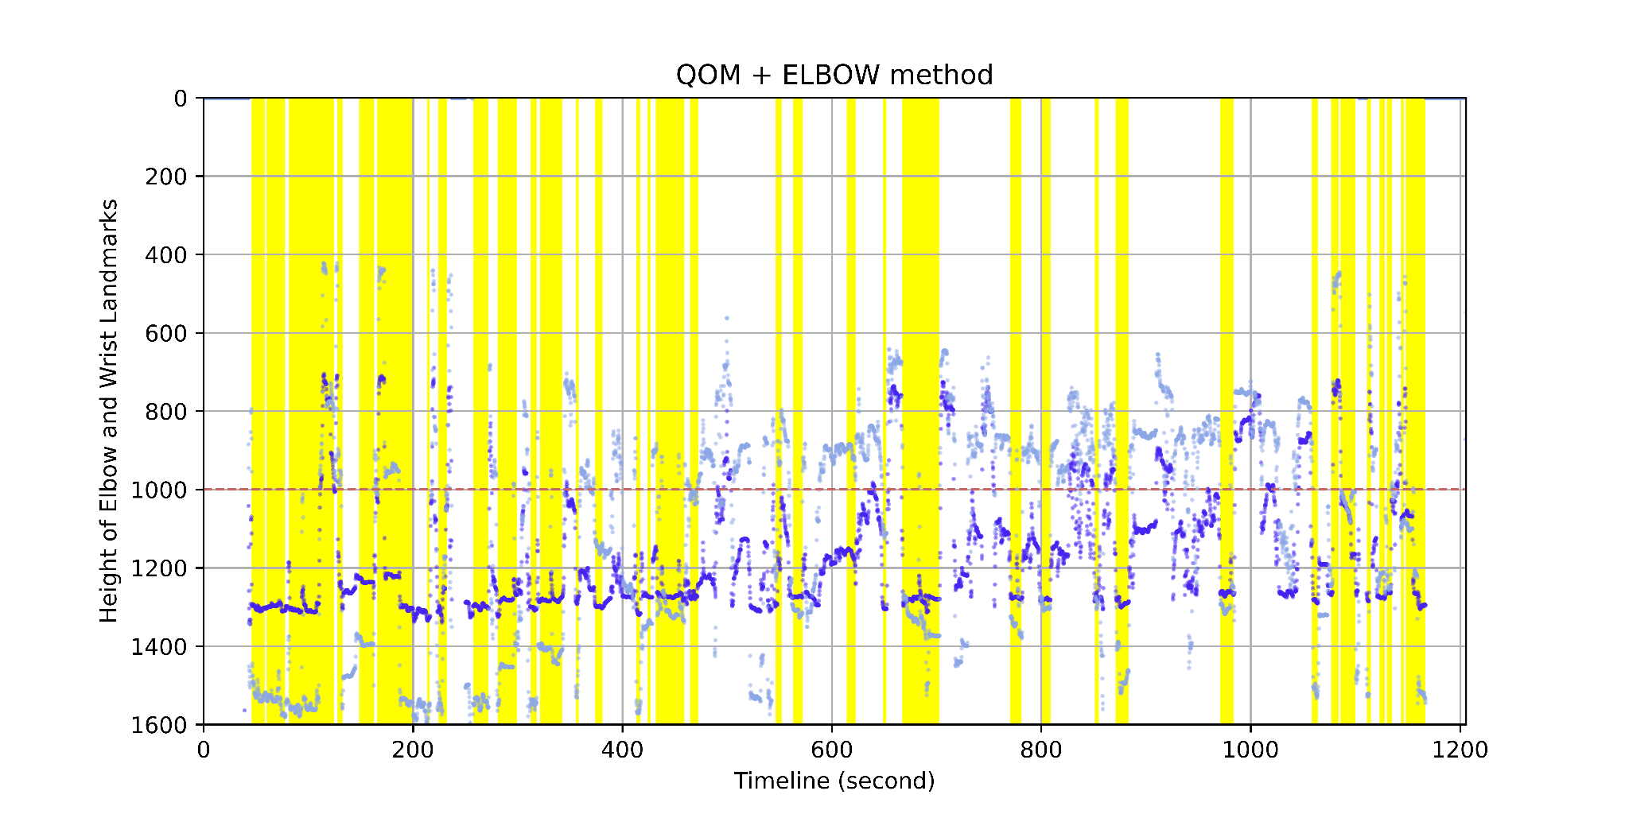
Temporal Segmentation: Our Algorithms
skeleton data
spatial distribution of elbows: find preliminary static positions
Velocity to quantify local movements
elbow distance to static positions
thresholding
thresholding
smoothing
clips
Notes:
This is the segmentation result for one of the research videos. the dark blue points represent the height of the left elbow, light blue points represent the height of left wrist. The yellow colored time periods are classified as rest times, the remaining time periods are recognized as containing gestures excluding the start and end. interestingly, we see that in most of the rest time, the wrist is below the elbow, which is consistent with our intuition that people in rest position naturally put their arm down.

Slide 11
Simple Hand-Gesture Detection
One important feature of active gesture chunk: Gesture of Hand
8 distinct categories:
• Palm
• Fist
• Thumb Up
• Indexing
• L-shape
• Relax
• Other
• Missing
Other

Slide 12
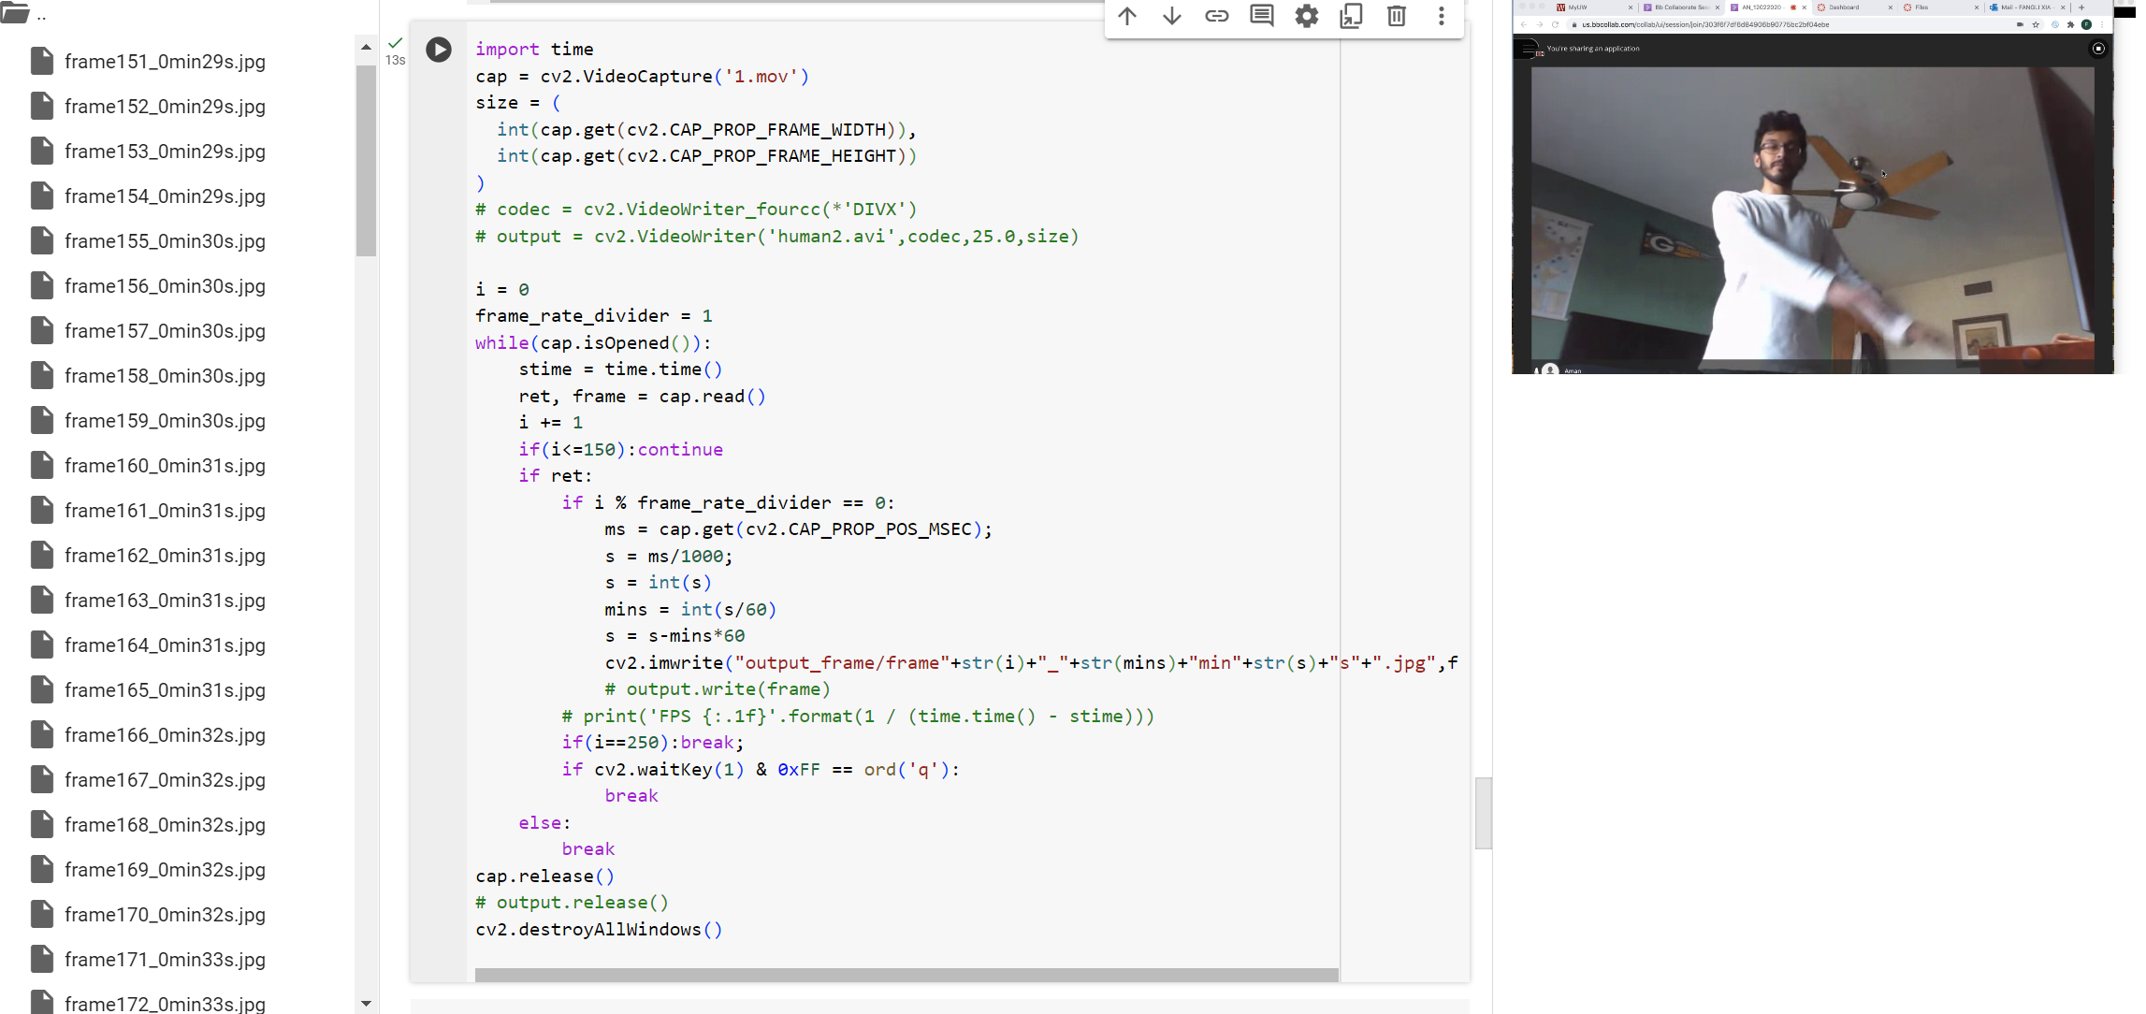
Method:
1) Extract Frame

Slide 13
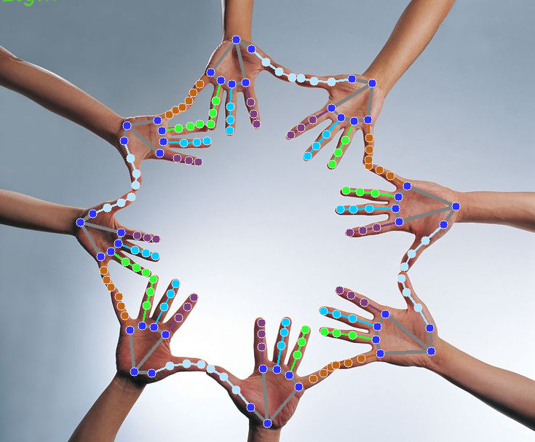
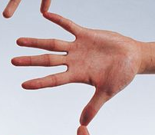
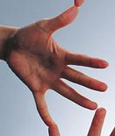
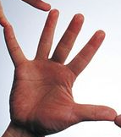
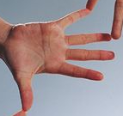
Simple Hand-Gesture Detection
2) Crop Out Hand using MediaPipe

Slide 14
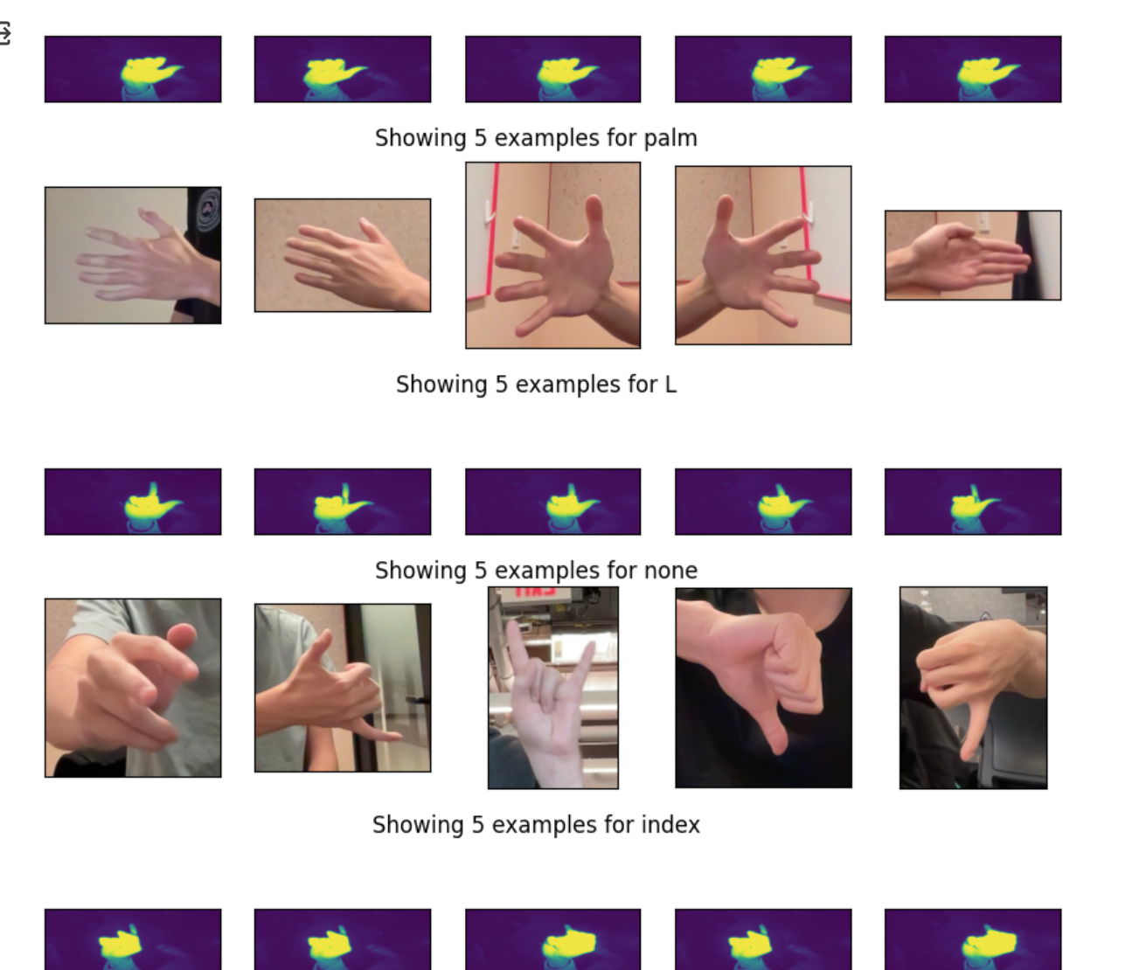
Simple Hand-Gesture Detection
3) Train Gesture Classification and apply: 80% for train 10% for val, and 10 for test

Slide 15
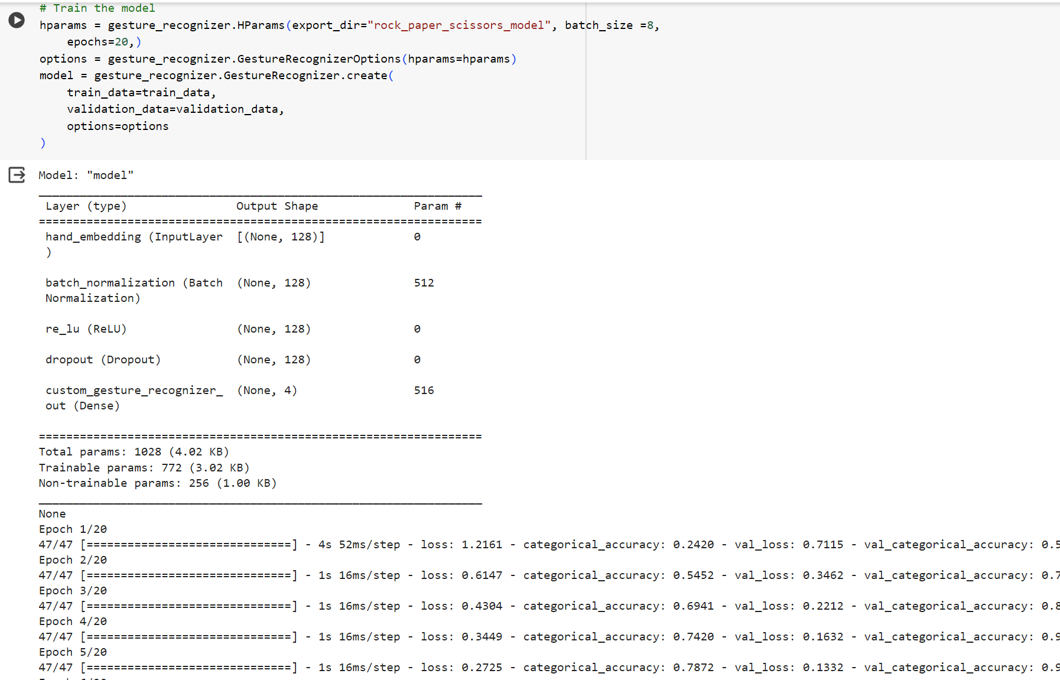
Simple Hand-Gesture Detection
3) Train Gesture Classification and apply

Slide 16
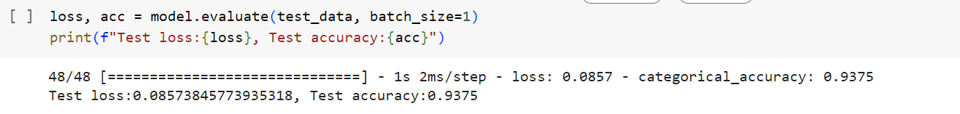
Simple Hand-Gesture Detection
3) Train Gesture Classification and apply

Slide 17
Simple Hand-Gesture Detection
To simplify our project, we aim to recognize hand gestures in eight distinct categories:
• Palm
• Fist
• Thumb Up: extending the thumb
• Indexing: extending the index finger
• L-shape: extending both the thumb and index finger to form an L-shape
• Relax: the hand in a relaxed state
• Other: any other hand positions
• Missing: insufficient hand landmarks detected for classification

Slide 19
Keyframe Extraction
Purpose
Use less frames to represent a gesture chunk
Algorithm
(Wrists) Velocity and position-based filtering
Example Results
Scenario: a student explaining whether “the lengths of the two diagonals of a rectangle are the same”
Duration: 30 sec
Original Frames: 129
Extracted frames: 15

Slide 20
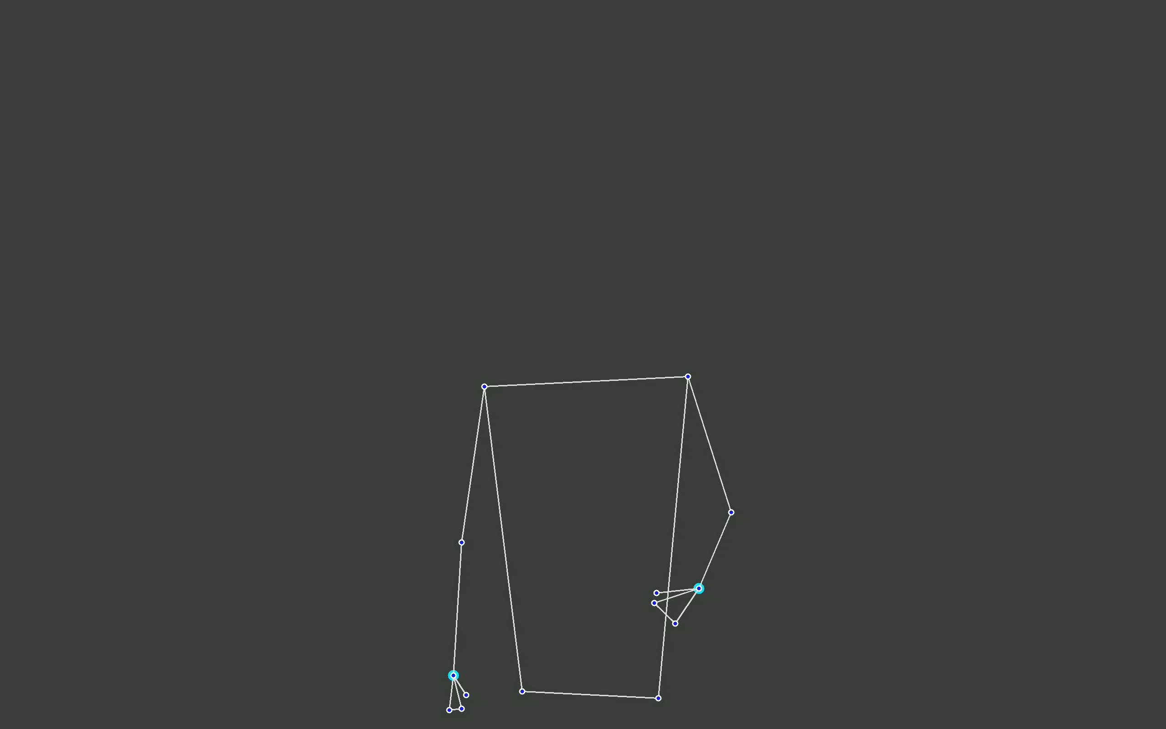
Video from 129 Original Frames
Question: “Are the lengths of the two diagonals of a rectangle the same?”

Slide 21
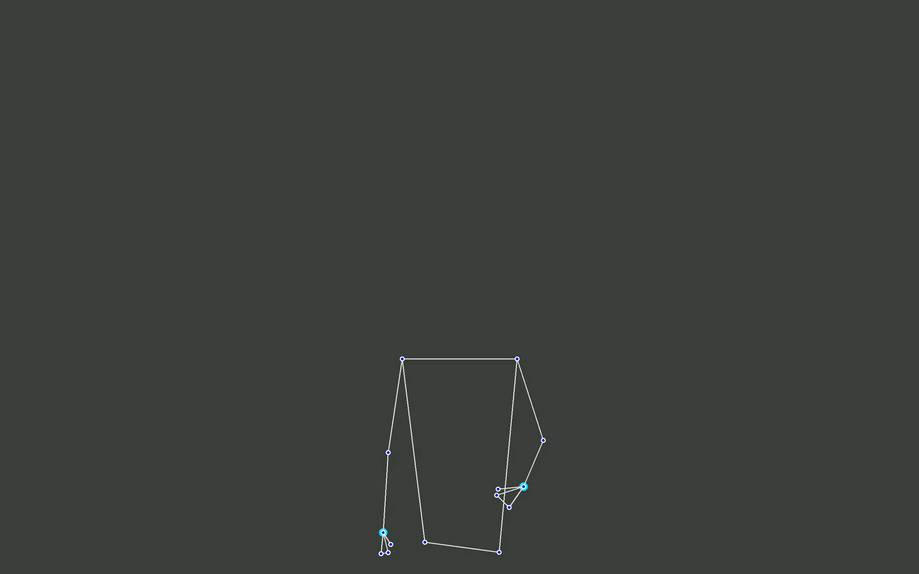
Video from 15 Extracted Keyframes

Slide 22
Challenges
Label: Abstract nature of targeted gestures
Noise: Presence of various noise types
Feature: Absence of an intermediate feature construction layer
Data: Limited dataset size post-'idle' state removal and inaccuracies in landmark detection by MediaPipe

Slide 23
Future Directions
Enhance baseline algorithms for better feature extraction
Strengthen algorithm robustness by incorporating edge cases
Integrate keyframe extraction with hand gesture recognition
Construct models using gesture chunks for simple gesture identification
Advance the model to recognize more abstract gestures

Slide 24
Thank You!
From Group
“Dreams Kindle Hope, Transforming New Ideas.”

